Slide 1
OBJECT DETECTION IN POINT CLOUD: ROAD BOUNDARY
ARPIT PATEL-A20424085
HITANSHU RAMI-A20458137
HARIHARAN SHANKAR-A20442562

Slide 2
INDEX
Problem Statement
Introduction
Road Boundary Detection
Coordinate Transformation
Approach
Results
Steps To Run Project
References

Slide 3
PROBLEM STATEMENT
The main objective is to visualize the given point cloud data in the fuse file and use it to find the guardrail boundary (road boundary) and plot them.

Slide 4
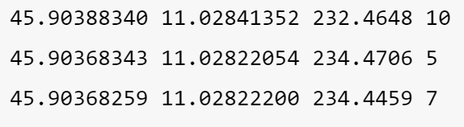
INTRODUCTION
What is Point Cloud Data?
Point clouds are datasets that represent objects or space.
Point clouds are generated using 3D laser scanners and LiDAR (light detection and ranging) technology and techniques.
Each point represents a single laser scan measurement.
A point cloud may define the shape of some real or created physical system.
This is being used as the input and is taken from final_project_point_cloud.fuse file.

Slide 5
ROAD BOUNDARY DETECTION
Object detection in point cloud HD maps is one of the application in self driving autonomous vehicles.
There are basically four types of object to consider Road surface, Pole, Guardrails and Lane marking.
Road boundary can be found with the help of detecting of guardrails or crubs present in the road.

Slide 6


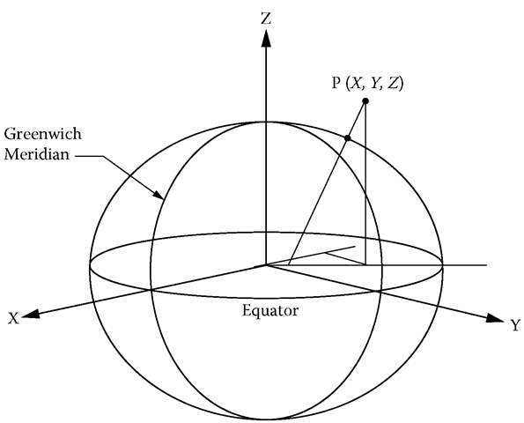
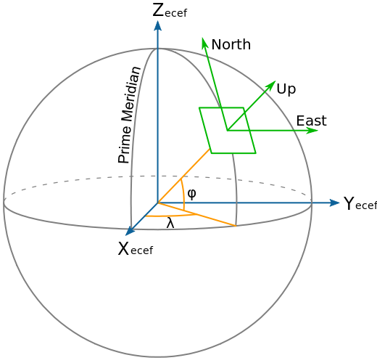
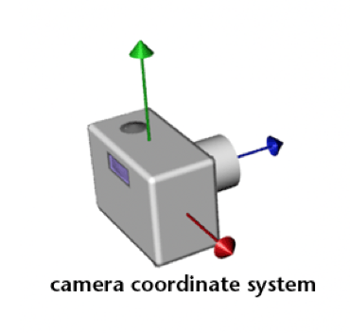
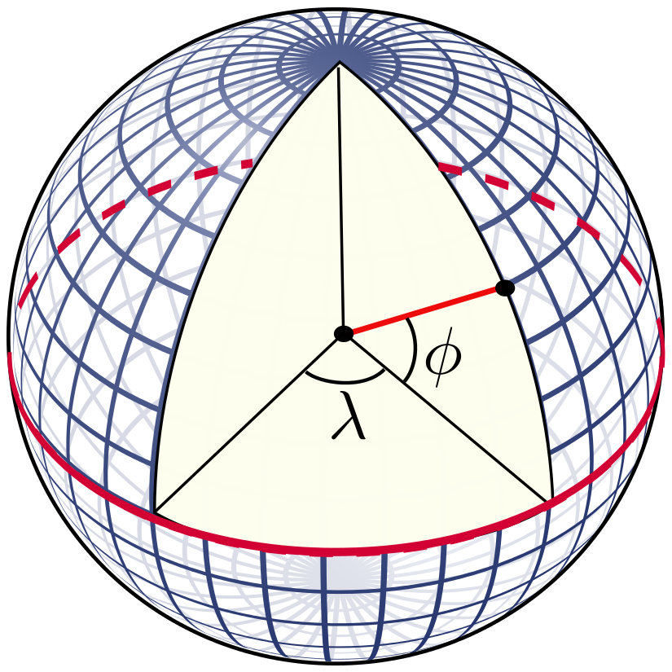
COORDINATE TRANSFORMATION
LLA
CAMERA

Slide 7
APPROACH
Loading data
Input the data from the FUSE File and Coordinate Change to ENU coordinates.
Use the pandas library to input the data – latitude, longitude, altitude, intensity.
Convert the data into ENU Coordinates using Pyproj library.

Slide 8
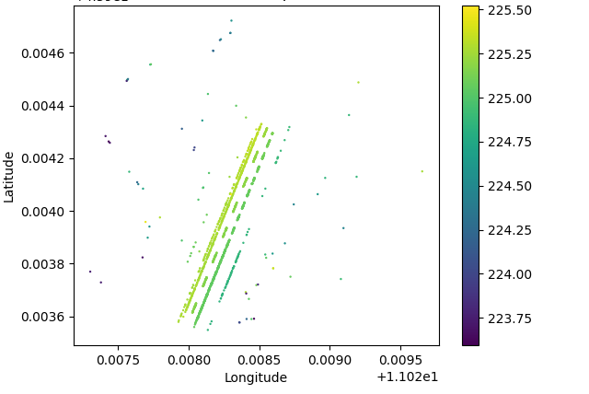
APPROACH
Filtering
Road surface is the major part of the point cloud.
Threshold filtering with mean and, standard deviation of intensity of the points.
Guardrail points have high curvature and this is used to distinguish from other points.
Using the trajectory data of given points we can remove the points which acts as a noise.

Slide 9
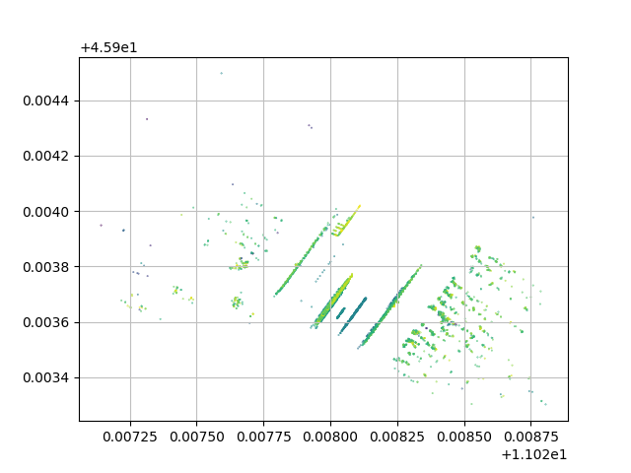
APPROACH
DBSCAN Clustering
What is Clustering?
Clustering is a Machine Learning technique that involves the grouping of the data points. Data Points in the similar group should have similar properties and features.
The full form of DBSCAN is Density-Based Spatial Clustering of Applications with Noise.
DBSCAN begins with a starting data point that has not been a visited and the neighbors of this data point is visited using distance epsilon.
Once we done with current cluster another unvisited point retrieved and that leads to another cluster. If some point not belongs to cluster it marked as a noise.

Slide 10
APPROACH
Storing output and Plotting the guardrail
After filtering and clustering is done, the points are stored in a separate csv file which consists of guardrails points.
Then, we plot the point of guardrails and lane in road in 3-D plot.
And then we plot guardrail alone in a 2-D plot from bird's viewpoint.

Slide 11
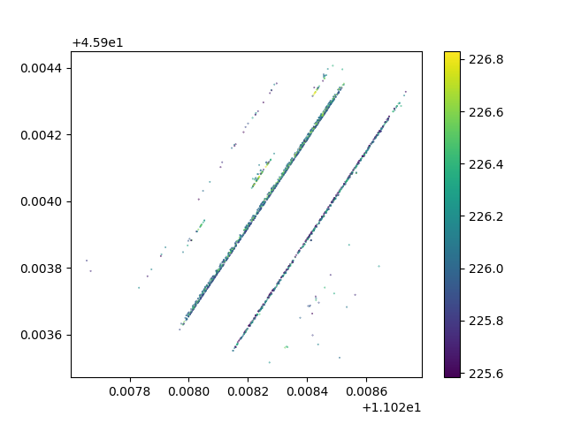
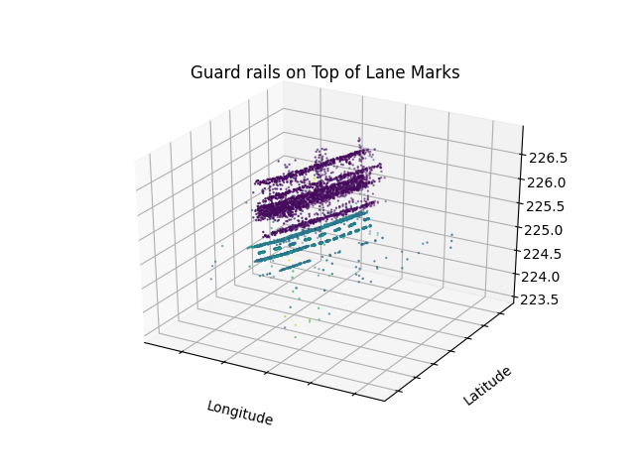
RESULTS
Scatter 2D-plot of GuardRail is plotted
Scatter 3D-plot of GuardRail is plotted

Slide 12
STEPS TO RUN PROJECT
Make sure you have a point cloud .fuse file and a camera configuration file.
To run command:
python3 script.py [.fuse] [.config]
Example:
python3 script.py ./final_project_data/final_project_point_cloud.fuse ./final_project_data/image/camera.config
The script will output a .csv file containing the point cloud data for guard rail and the matching lane boundaries. It also outputs a 2D (bird-eye view) and 3D image of the guard rail data points.

Slide 13
REFERENCES
Coordinate Transformation PPT by Prof. Xin Chen
https://info.vercator.com/blog/what-are-point-clouds-5-easy-facts-that-explain-point-clouds
https://pyproj4.github.io/pyproj/stable/api/proj.html
http://www.jeffdelmerico.com/wp-content/uploads/2014/03/pcl_tutorial.pdf

Slide 14
Thank You

